Slide 1
Results.
Report
Monthly Results Report Sample

Slide 2
Highlights
[logo]
Ads are improving as we run the campaign longer – Google Ads has 5.4x ROAS (vs 5x last month)
FB ads are also proving effective at 6.3x ROAS for our initial trial. Proposal is to skew more spends to FB while optimising creative
Website seeing better funneling of customers to purchase (1.01% conversion rate vs 0.6% last report)
5.4x
6.3x
Search Ads ROAS
(vs 5x last month)
Facebook Ads ROAS for our initial trial
6%
Even higher
Clickthrough Rate
(vs 4.7% last month)

Slide 3
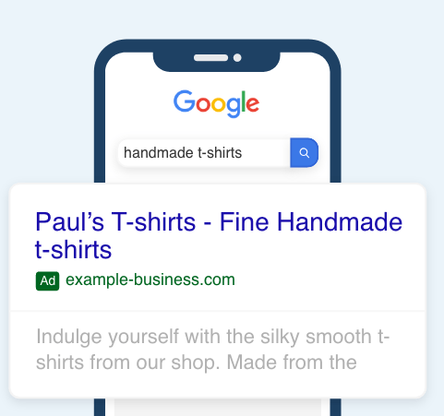
Google Search Ads
What did we get for our spend in Google Ads?
AWARENESS
Impressions
14,109
wine delivery australia
850
Wine Cellars – Order Now | Artisanal Wines
| Delivered to Your Door
ENGAGEMENT
Clicks
6.02%
(vs 4.77% last month)
winecellars.com.au
14
$4,140 value
Highlights:
ROAS remains healthy and even improved (5.4x vs 5x)
Clickthrough Rate (CTR) also improved (6% vs 4.7%) – indicating ads are being better optimised the longer we run our campaign
Browse Sydney's most diverse selection of wines.
A fresh selection of unique wines, straight to your doorstep.
CONVERSION
Purchase
1.7%
(vs 1.9% last month)
$52 per purchase (vs $54 last mo.)
5.4x return on spend (5x last mo.)

Slide 4
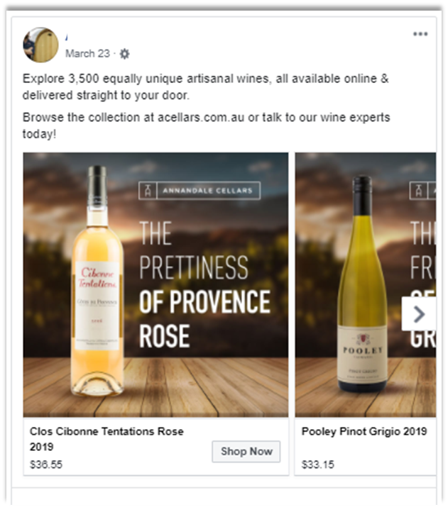
Facebook Ads
What did we get for our spend in Facebook Ads?
AWARENESS
Impressions
9,732
178
ENGAGEMENT
Clicks
1.8%
2
$861 value
Highlights:
Great ROAS at 6.3X driven by the ‘Selections’ ad
CTR at 1.8% is above average (vs 1% avg). We can still optimise using learnings from each creative
CONVERSION
Purchase
1.1%
$68 per purchase
6.3x return on spend

Slide 5
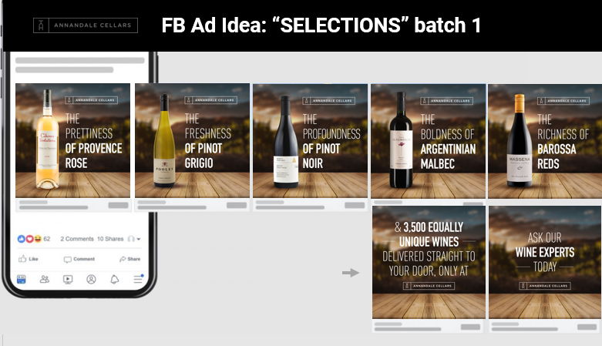
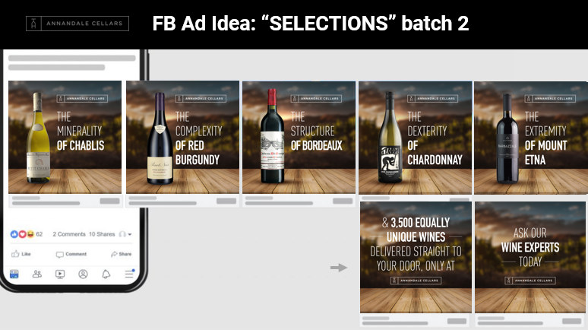
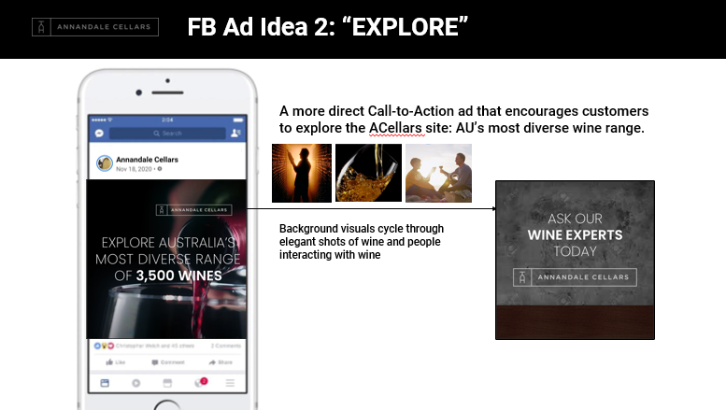
Facebook Ads
FB ads breakdown:
Our Selections ad (carousel format) drove the sales – we will proceed with this format while optimising creative
 | Spent | Revenue | ROAS
Selections (batch 1) | $43 | 0 | Na
Selections (batch 2) | $35 | $861 | 24.6x
Explore | $58 | 0 | Na
Amount spent is dynamically allocated by FB’s algorithm

Slide 6
Comparing Google & FB
Great ROAS for both FB (6.3x) & Google Ads (5.4x). Recommendation to proceed with higher spend in FB for coming weeks given higher return
Actualised
(Feb to Apr 13)
Proposed
(Apr 13 –May 15)
 | Spent | Revenue | ROAS | Reco Spend
Facebook | $137 | $861 | 6.3x | $350 (60%)
Google Ads | $773 | $4,140 | 5.4x | $240 (40%)
Forecast total advertising spend for three months: $1,500 ($500/mo) + $150 free ad credit = Total of $1,650

Slide 7
How is our site performing in funneling customers to purchase?
Website
Legend: Current% (vs Previous%)
PAGE
VIEWS
    Website improving generally across the funnel – with 1.01% purchase conversion (vs 0.6% last report)
    Opportunity is still on helping customers decide which wine to buy (or featuring best-sellers/recommendations) – given ATC% of 5.66% being weakest link
9,926
5.66%
(vs 3.67%)
ADD TO
CART
562
34%
(vs 36%)
61%
(vs 44%)
INITIATE CHECK
OUT
87%
(vs 100%)
100%
(vs 100%)
189
ENTER
CUSTOMER
INFO
SELECT SHIPPING & PAY METHOD
PURCHASE
100
115
Period covered: Mar 13-Apr13, 2021 when funnel functionality has been coded in
100
1.01%
(vs 0.6%)

Slide 8
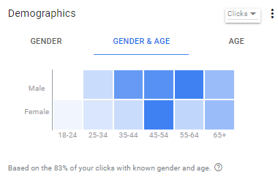
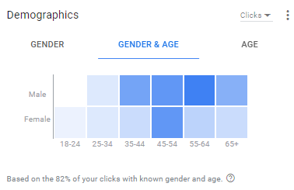
Google Search Ads
What insights can we get from our customers?
Latest Report
ON GENDER & AGE
Not much change vs previous report
Most of the people who engaged with our ads are Male aged 35-64
Within Females, the 45-54 age group also engaged with our ads the most
Previous Report

Slide 9
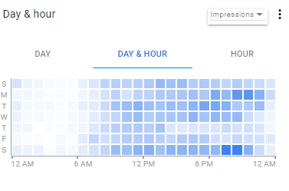
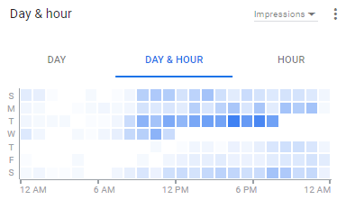
Google Search Ads
What insights can we get from our customers?
Latest Report
ON DAY & HOUR
Our ads now appear more regularly across days
‘Primetime’ is still within evenings from 5-9pm though
Previous Report

Slide 10
Site Conversion Funnel, before & after SSO
APRIL
Apr 9-30
MAY
May 1-11
0 - PAGEVIEW
1216
665
Clear improvement in site funnel conversion rate from April to May with the SSO option:
From 0.6% to 1.8% conversion (3x improvement)
1 – SIGNUP PAGE
122
48
2 – EMAIL VERIF
29
6
skipped with SSO
3 – PHONE VERIF
11
15
4 – INVESTOR TYPE
9
13
5 - WELCOME
7
12
0.6% Conversion Rate
1.8% Conversion Rate

Slide 11
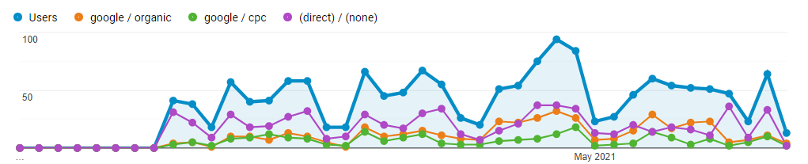
Site traffic updates
Daily users averaging at 50 on weekdays, 20 on weekends | Notable spike on users end of April (100/day)
Healthy ratio of organic-to-paid traffic (75-25), with direct site visits forming the biggest traffic source.
Total
Organic Search
Ads Traffic
Direct Site Visit

Slide 12
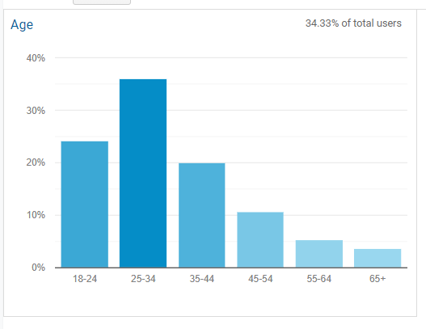
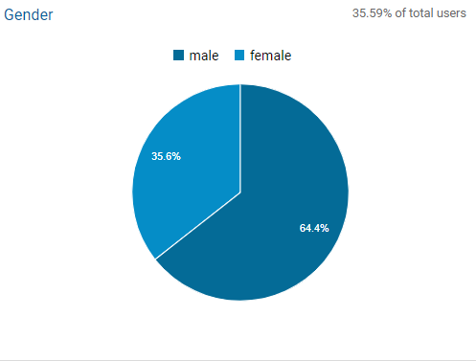
User insights – Age and Gender
AGE
Our userbase are mostly millennials aged 25-34
Side insight: 25-34 also have the highest session duration at 11m20s (vs 6m58s avg)
GENDER
Mostly males at a 65-35 male-female ratio

Slide 13
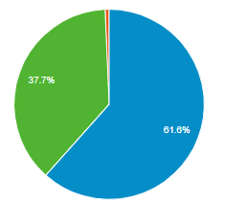
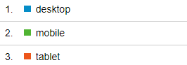
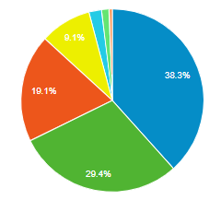
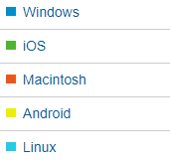
User insights – Device and OS
DEVICE TYPE USED
Mostly desktop at 60-40 desktop-mobile ratio (unique for Stropro, as sites usually have more users in mobile)
OPERATING SYSTEM
50% Apple (iOS+Mac)
50% Other OS (Windows+Android+others)

Slide 14
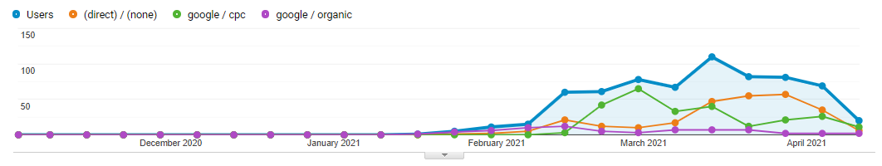
Website
Are we getting traffic to our website?
    Our SEO efforts and our search ads are bearing fruit:
    We’re tracking at an average of 80 unique website users weekly
    Traffic initially brought on by our Google Ads launch, but slowly driven more by Direct Site Visits as we build awareness
Week-by-week tracking of website unique users, by source
Notes:
Vivvino ppc – been running since August 2015

Slide 15
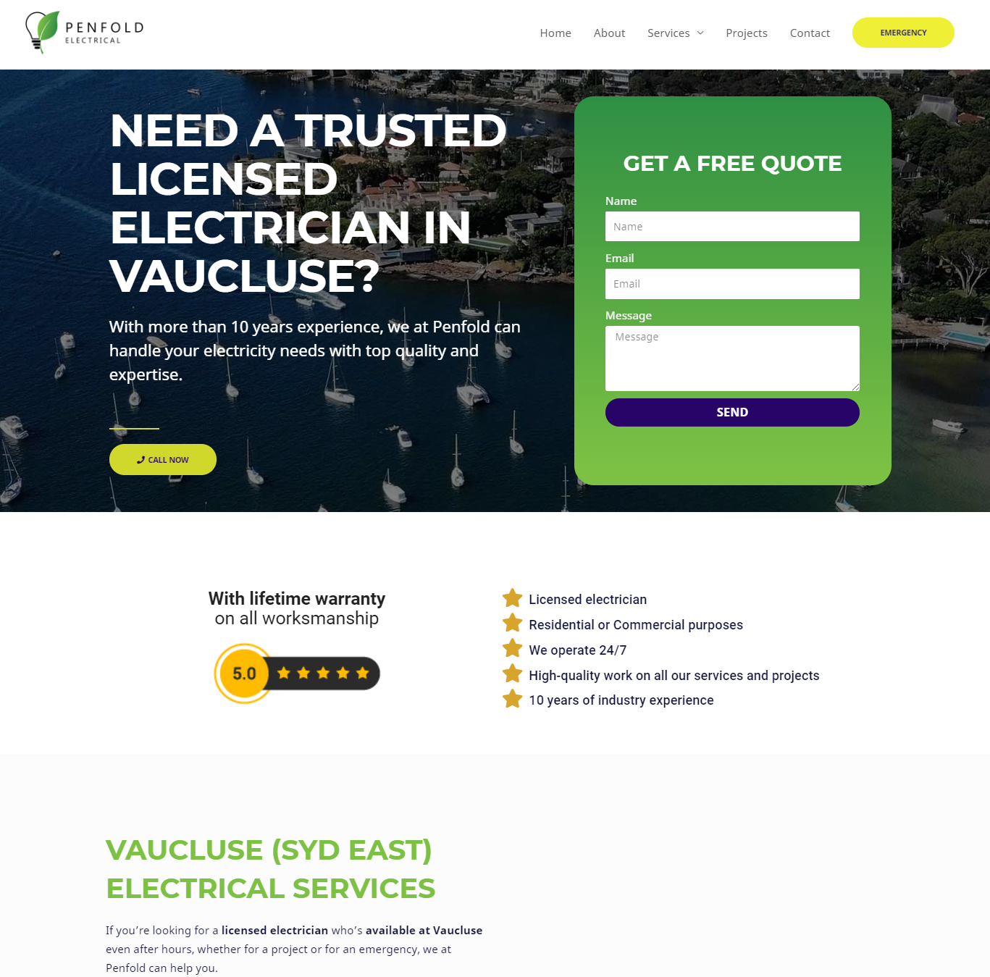
Website
Initiative: Suburb-specific landing pages
    New landing pages to cater to people searching for “electricians in [suburb]”
    Can also be used to further optimise Google Ads to serve as new landing pages
Any input on content/wording? Let us know and we’ll fix it

Slide 16
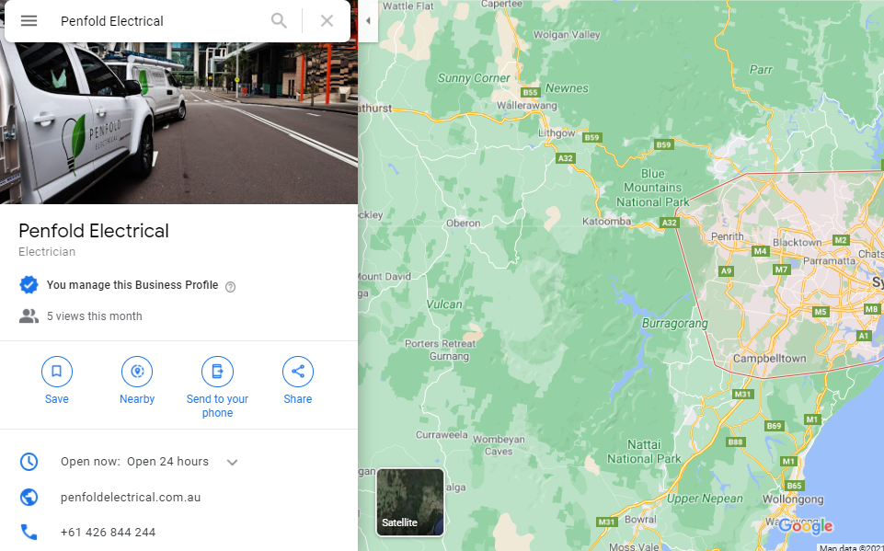
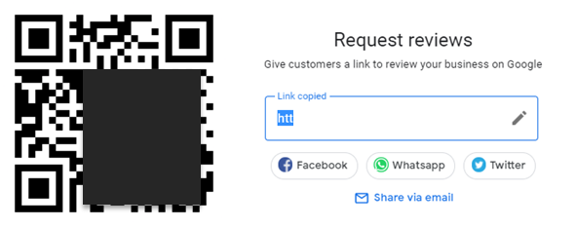
Update: Google My Business listing is now live!
Recommendation is to get reviews from every customer
Google My Business
Ask for reviews immediately after work completion
Can be via QR code or shortlink (see appendix for toolkit)

Slide 17
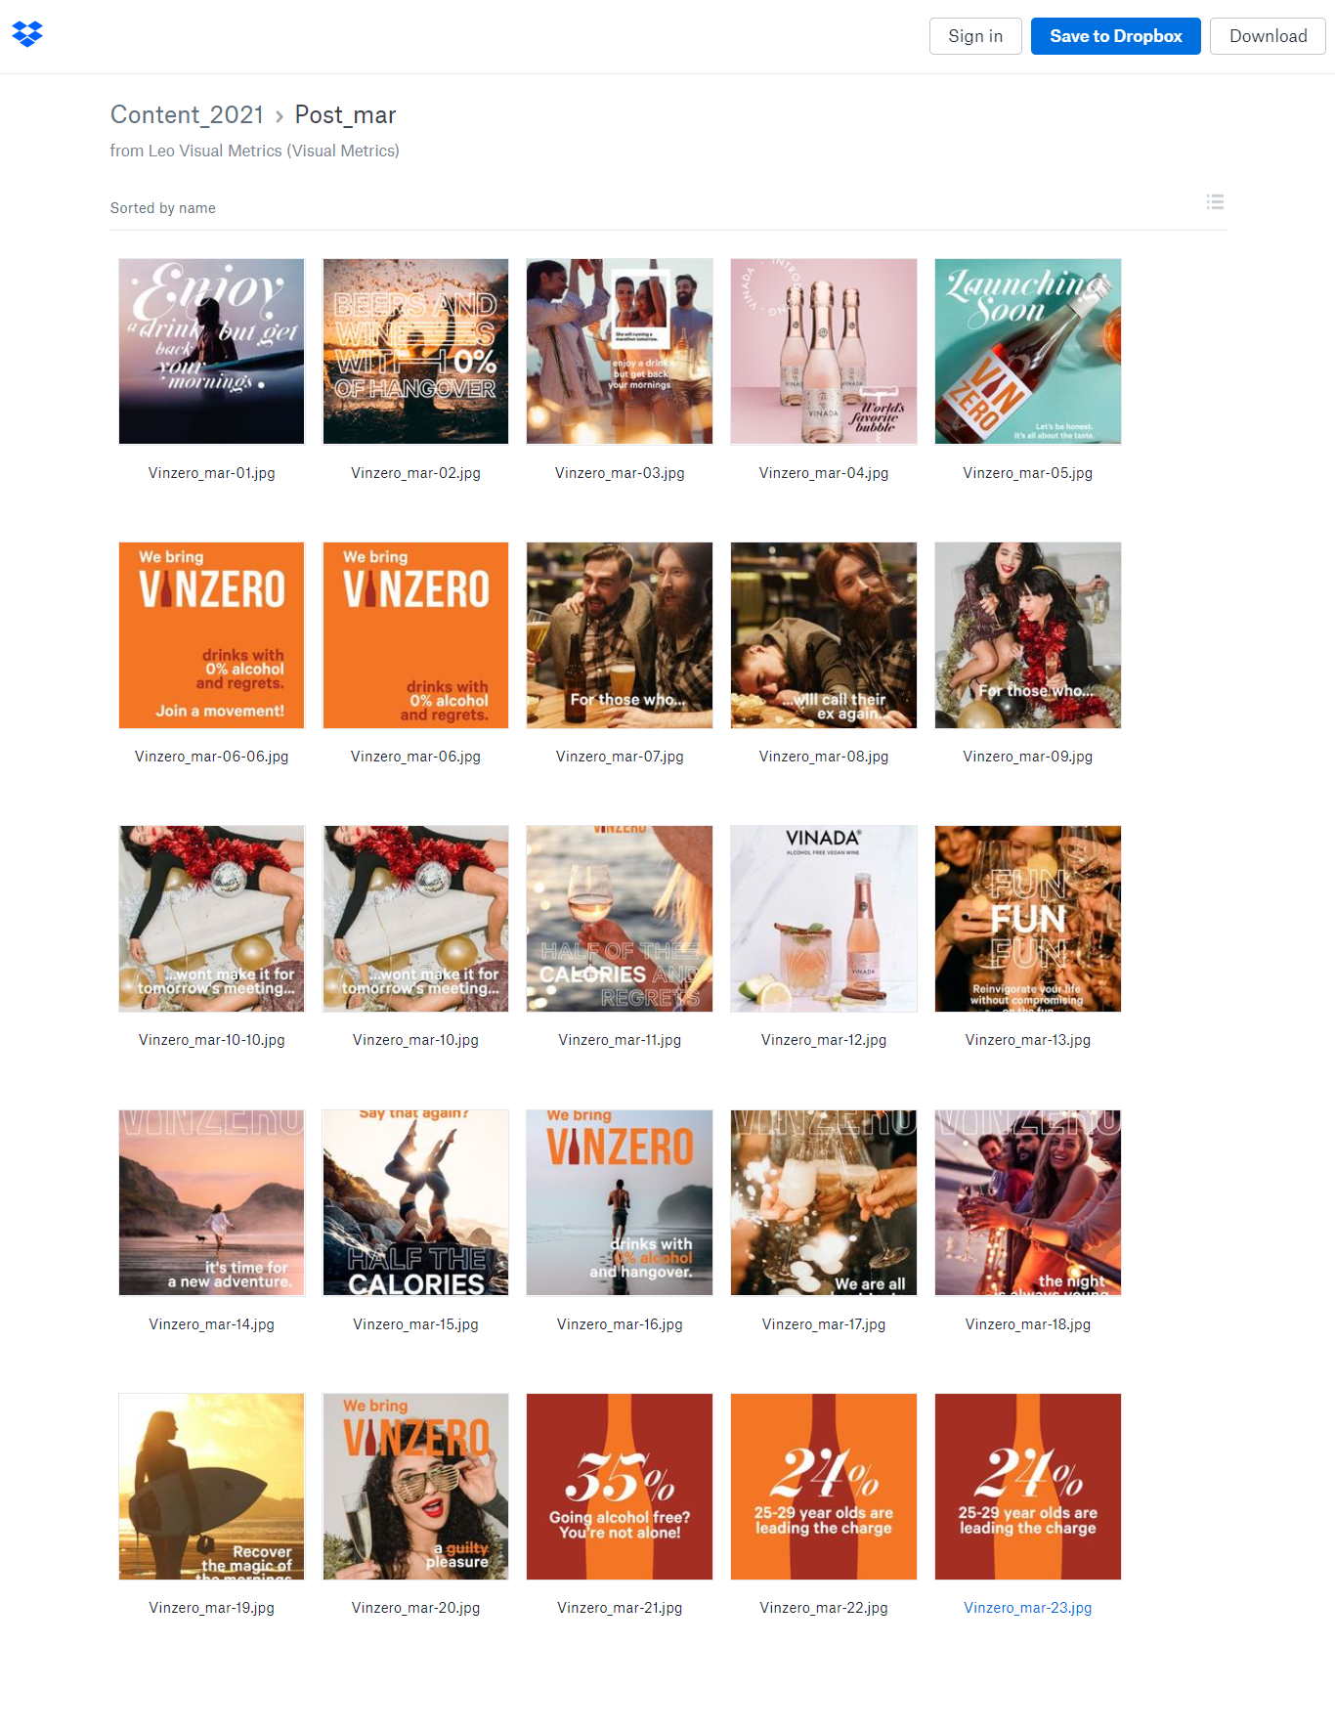
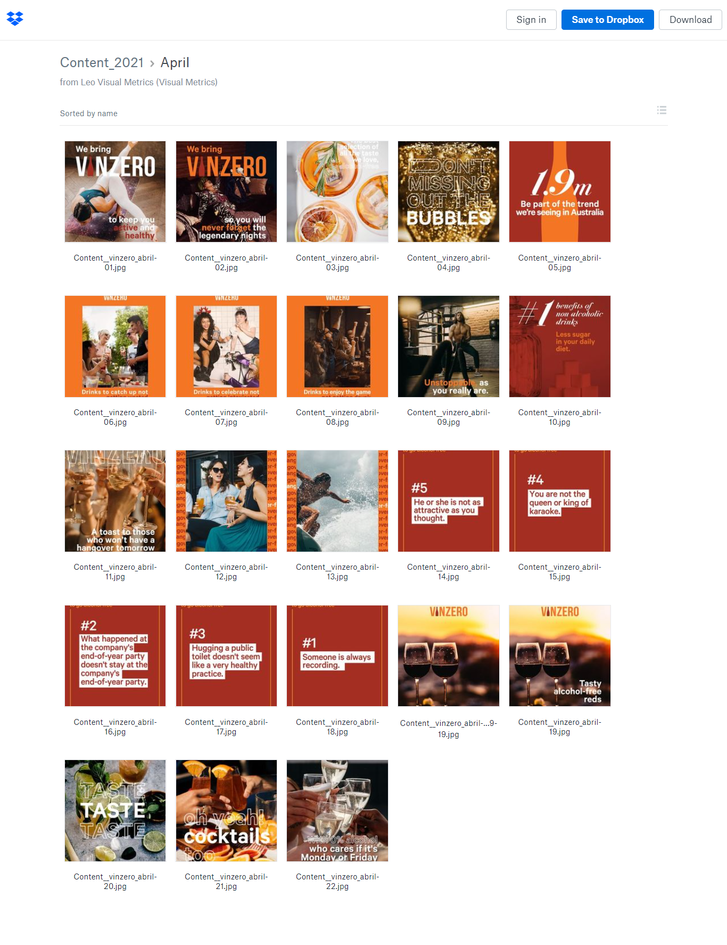
39 brand posts ready to go
16 already live and cross-posted in Instagram and Facebook
We went ahead and already made 23 more (with 14 more creatives to be made)
Remaining posts to be scheduled for April to May posting
LIVE | 16
READY TO POST | 23
TO CREATE | 14
TOTAL | 53 posts (24*2mos + 5 bonus)

Slide 18
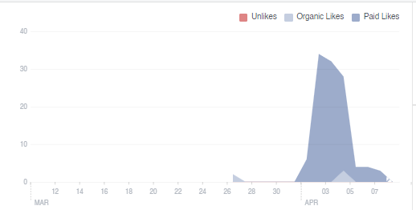

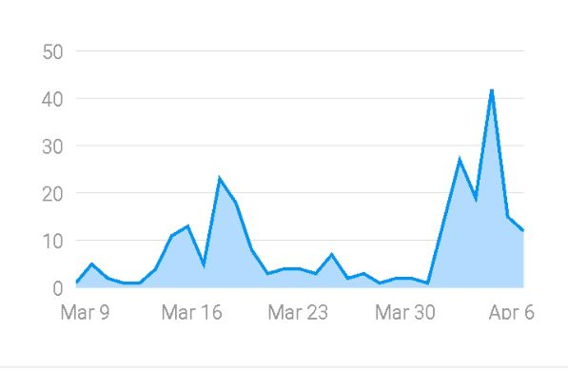

Where did our followers come from?
Facebook likers
FB Likes largely driven by paid boosting; expected given FB doesn’t excel in organic reach (i.e. no customer behavior of explore, hashtags)
SOURCE | FB Likers | Cost/Like
Boosting | 108 | $1.48
Organic | 35 | na
Instagram followers
A healthy mix of followers from paid boosting and organic reach. Given smaller cost/follow for IG, good to consider skewing advertising spend in favor of Instagram.
SOURCE | IG Followers | Cost/Follow
Boosting | 174 | $0.93
Organic* | 109 | na
*partially driven by Kicksta engagement

